Slide 1

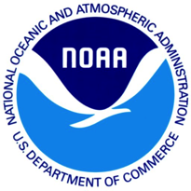




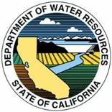


Decision Support Systems and From the Watershed to the
Ocean: Using NASA Data and Models to Understand and Predict
Variations in Central California Salmon
Elements from 2 Projects
NOAA
Eric Danner
Brian Wells
Steve Lindley
Andrew Pike
Lynn Dewitt
Kirstin Holsman
Jarrod Santora
NASA Ames
Rama Nemani
Forrest Melton
NASA JPL
Yi Chao
MBARI
Francisco Chavez
Monique Messié
University of Maine
Fei Chai
University of Colorado Boulder
Balaji Ragagopalan
Jason Caldwell
Farallon Institute
Bill Sydemon
University of California Santa Barbara
Roger Nizbet
Laure Pecquerie
California Department of Water Resources
Eli Ateljevich
Kijin Nam

Slide 2
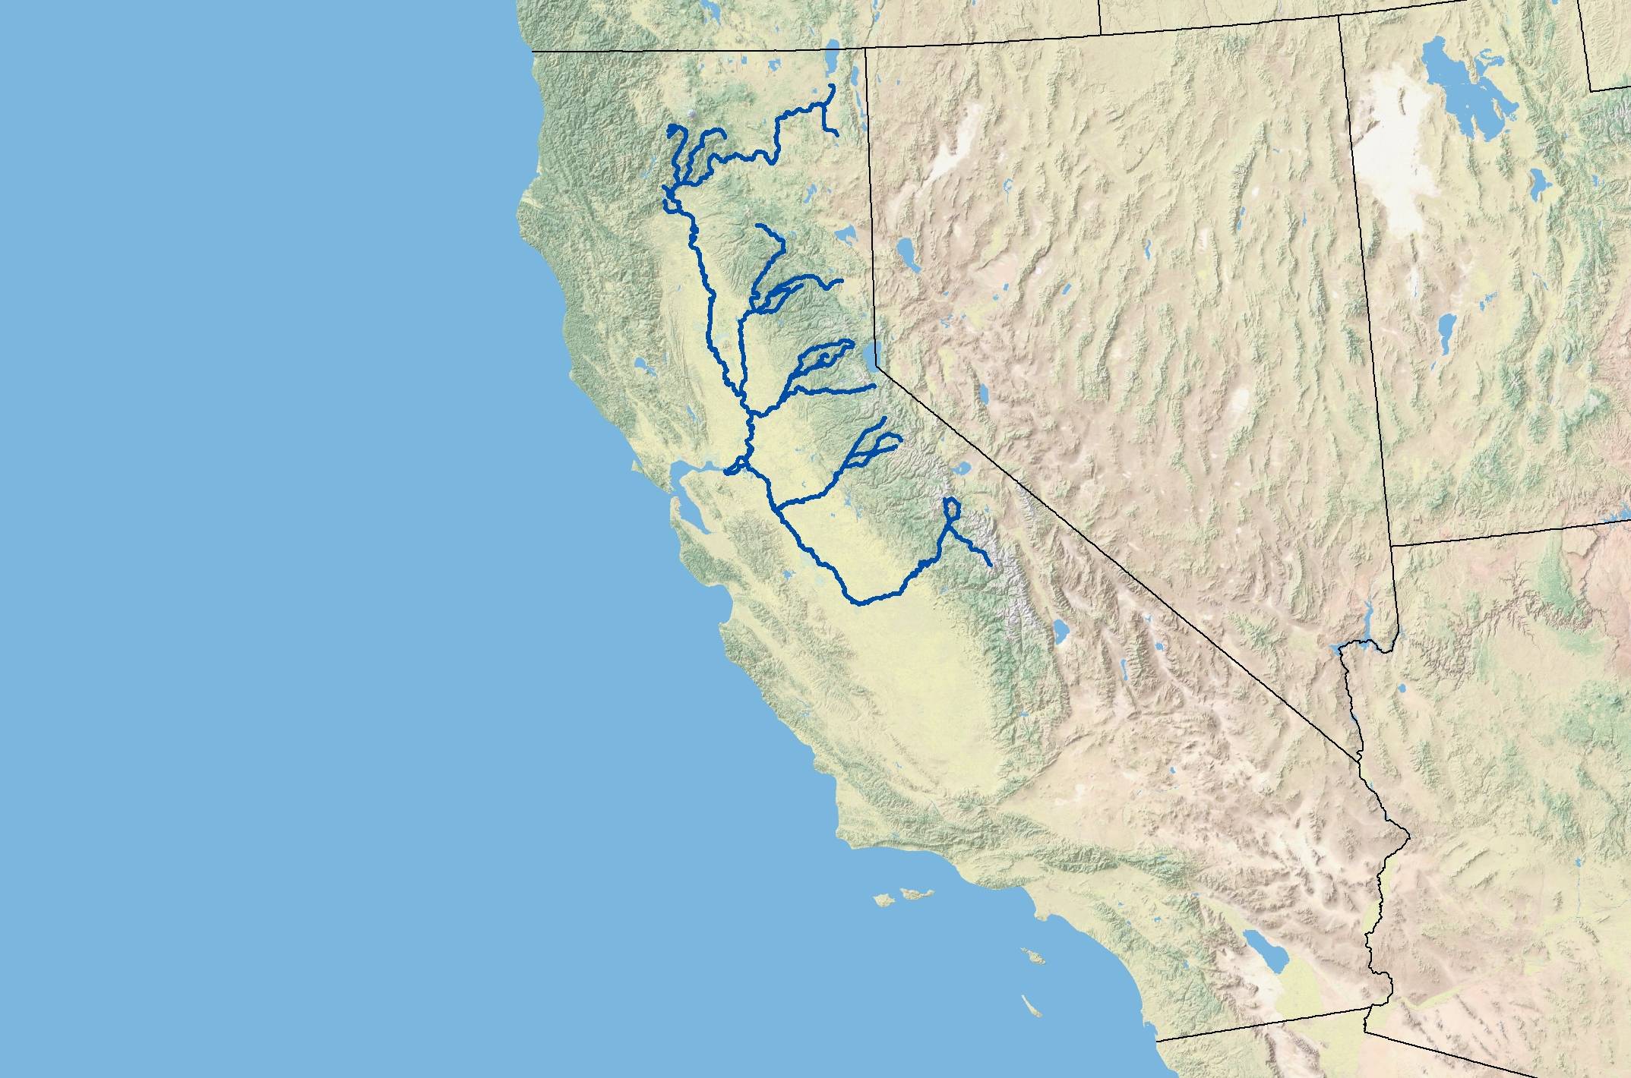
Salmon Life Cycle

Slide 3

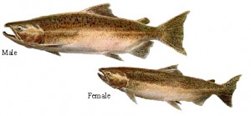


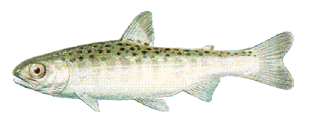
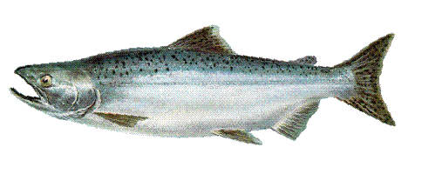
Salmon Life Cycle

Slide 4

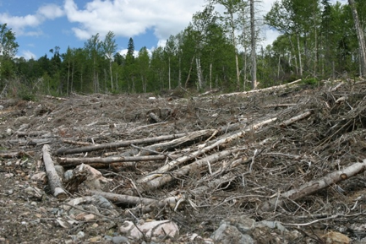
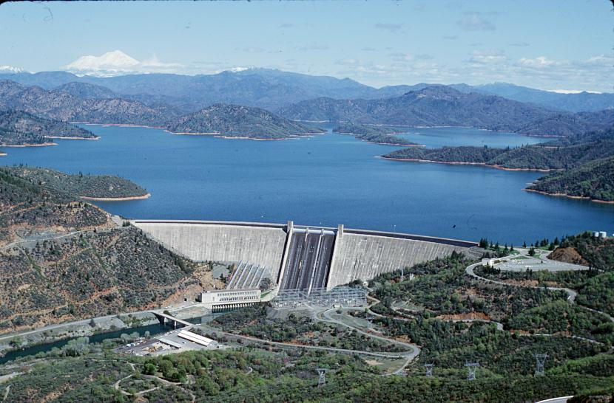
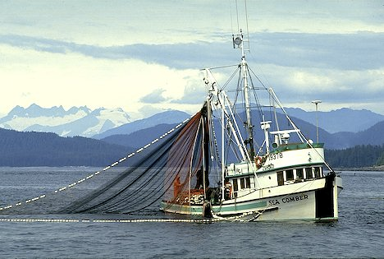
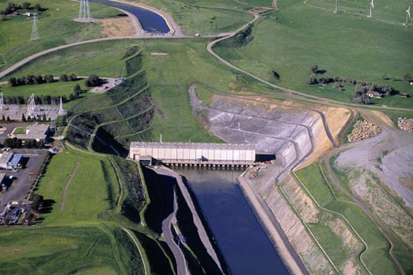
Anthropogenic Influences

Slide 5
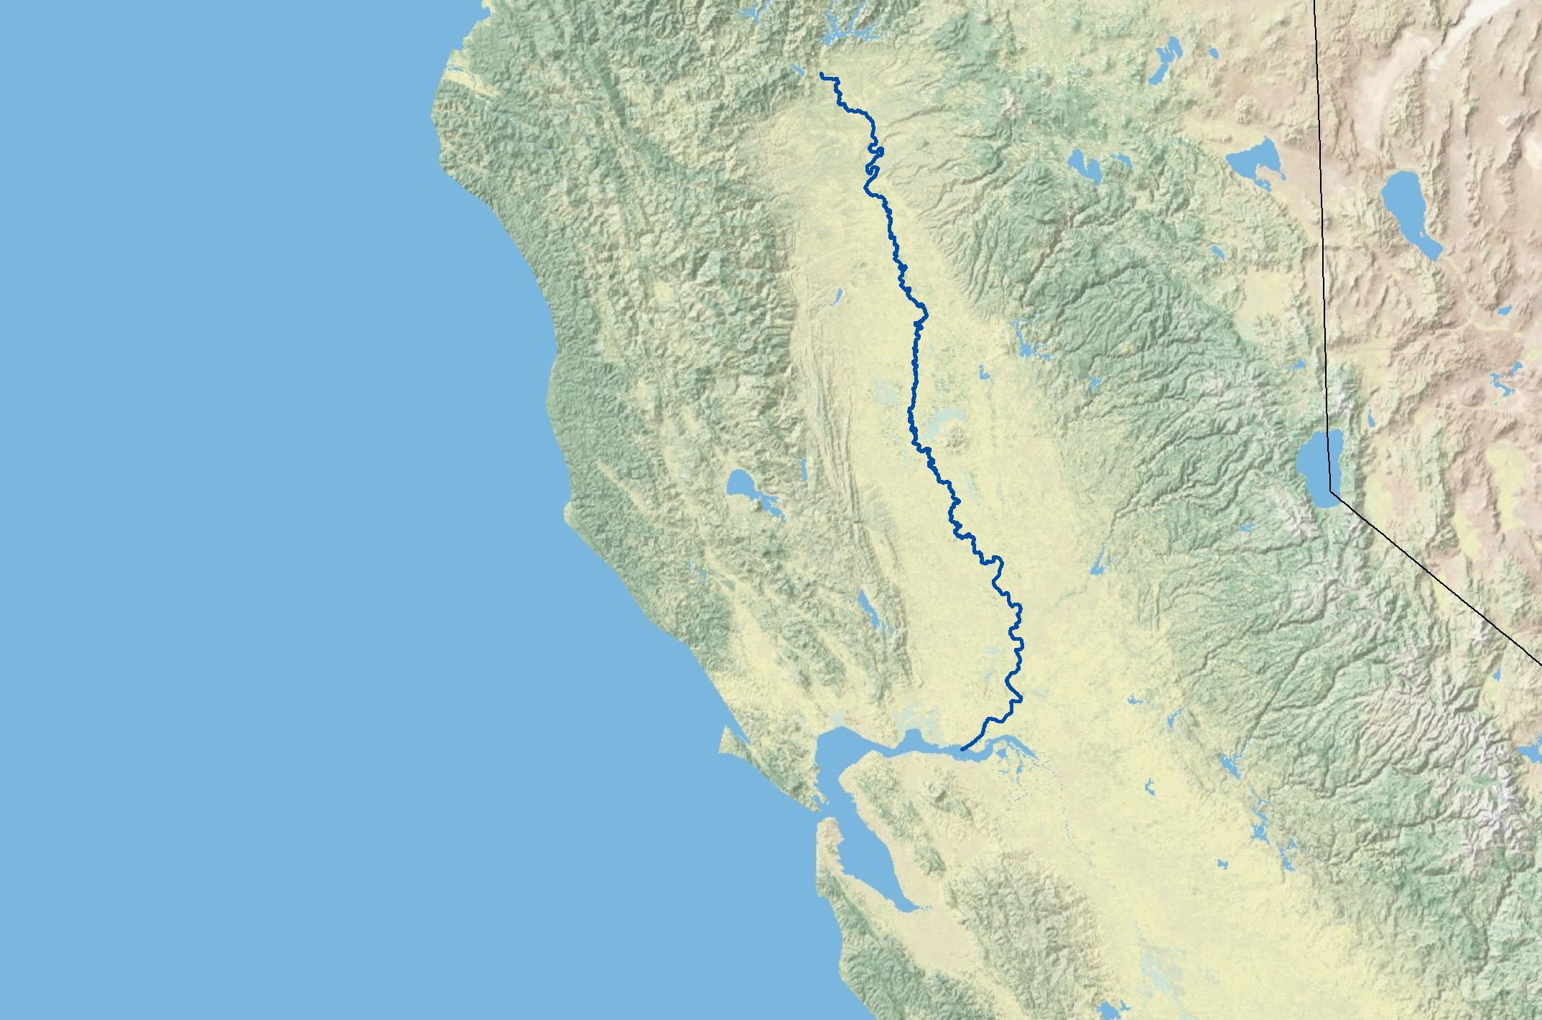
Study Sytem
Sacramento
River
City of Sacramento
San Francisco

Slide 6
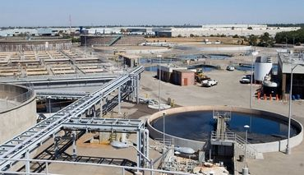
Management Options

Slide 7
Complex Landscapes
300km
Freshwater dynamics and the movement between complex landscapes...
…how can we capture this?

Slide 8
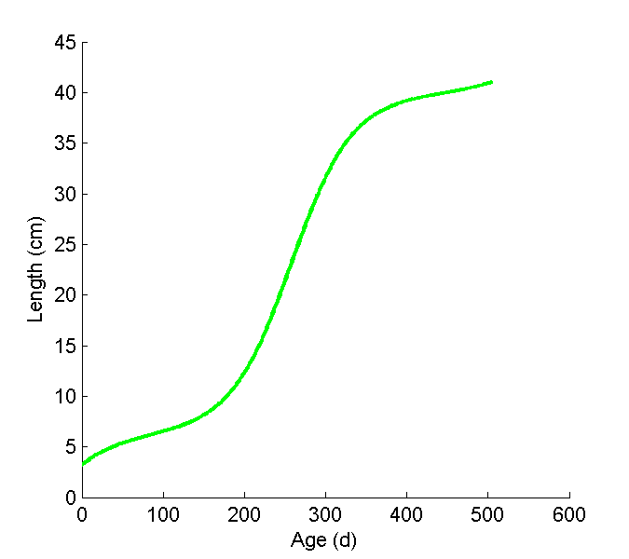
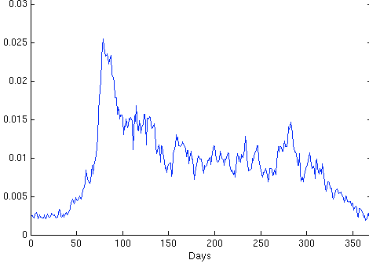
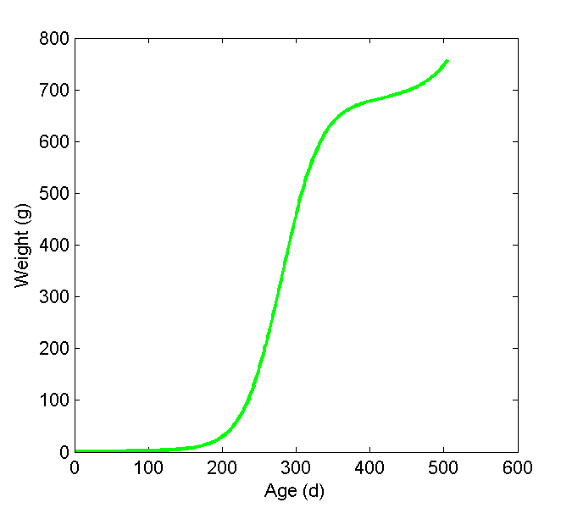
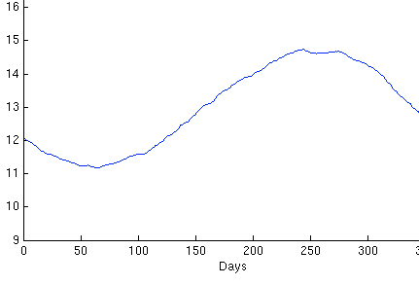
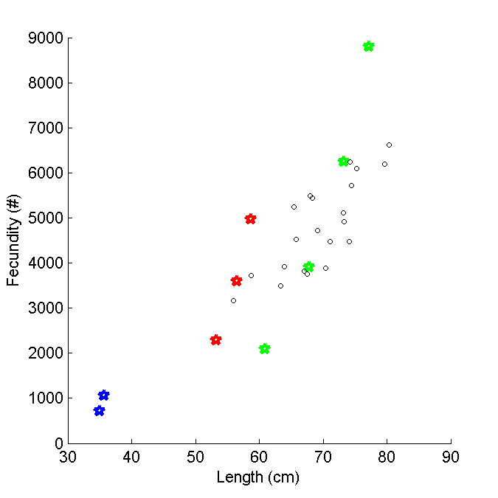
Dynamic Energy Budget (DEB) models
Length
Weight
Food density
Fecundity / egg size
Temperature
INPUTS
DEB MODEL
OUTPUTS

Slide 9
How do we get temperature and food?
3 coupled physical-biological models
3D temperature and salinity, water level, tidal fluxes
Water temperature and flow
ROMS
CoSiNE
SELFE
CoSiNE
RAFT
Food Web/ Production
Coupled Ocean Model
Coupled Estuary Model
Coupled River Model
Coastal Ocean
San Francisco Estuary
Upper Sacramento River

Slide 10
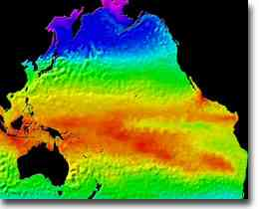
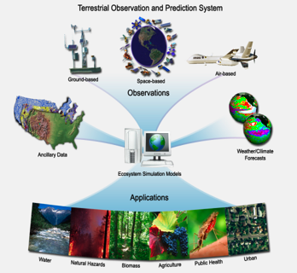
Oceans
Atmosphere & Land
AVHRR
MODIS
Quicksat
SeaWiFS COAMPS
Jason-1
OSTM/Jason-2
MODIS LAI
MOD15A2
TOPS-WRF
(coupled TOPS-BGC
and WRF)
ROMS
TOPS
3D temperature and salinity, water level, tidal fluxes
Water temperature and flow
ROMS
CoSiNE
SELFE
CoSiNE
RAFT
Food Web/ Production
Coupled Ocean Model
Coupled Estuary Model
Coupled River Model
Coastal Ocean
San Francisco Estuary
Upper Sacramento River

Slide 11
Oceans
Atmosphere & Land
ROMS
TOPS
3D temperature and salinity, water level, tidal fluxes
Water temperature and flow
ROMS
CoSiNE
SELFE
CoSiNE
RAFT
Food Web/ Production
Coupled Ocean Model
Coupled Estuary Model
Coupled River Model
Coastal Ocean
San Francisco Estuary
Upper Sacramento River
Water temperature
Food
Water temperature
Food
Water temperature
Food
Salmon DEB
Juveniles / Adults
Salmon DEB
Eggs / Juveniles
salmon growth and maturation
# salmon in fishery and viability of population
salmon growth and maturation

Slide 12
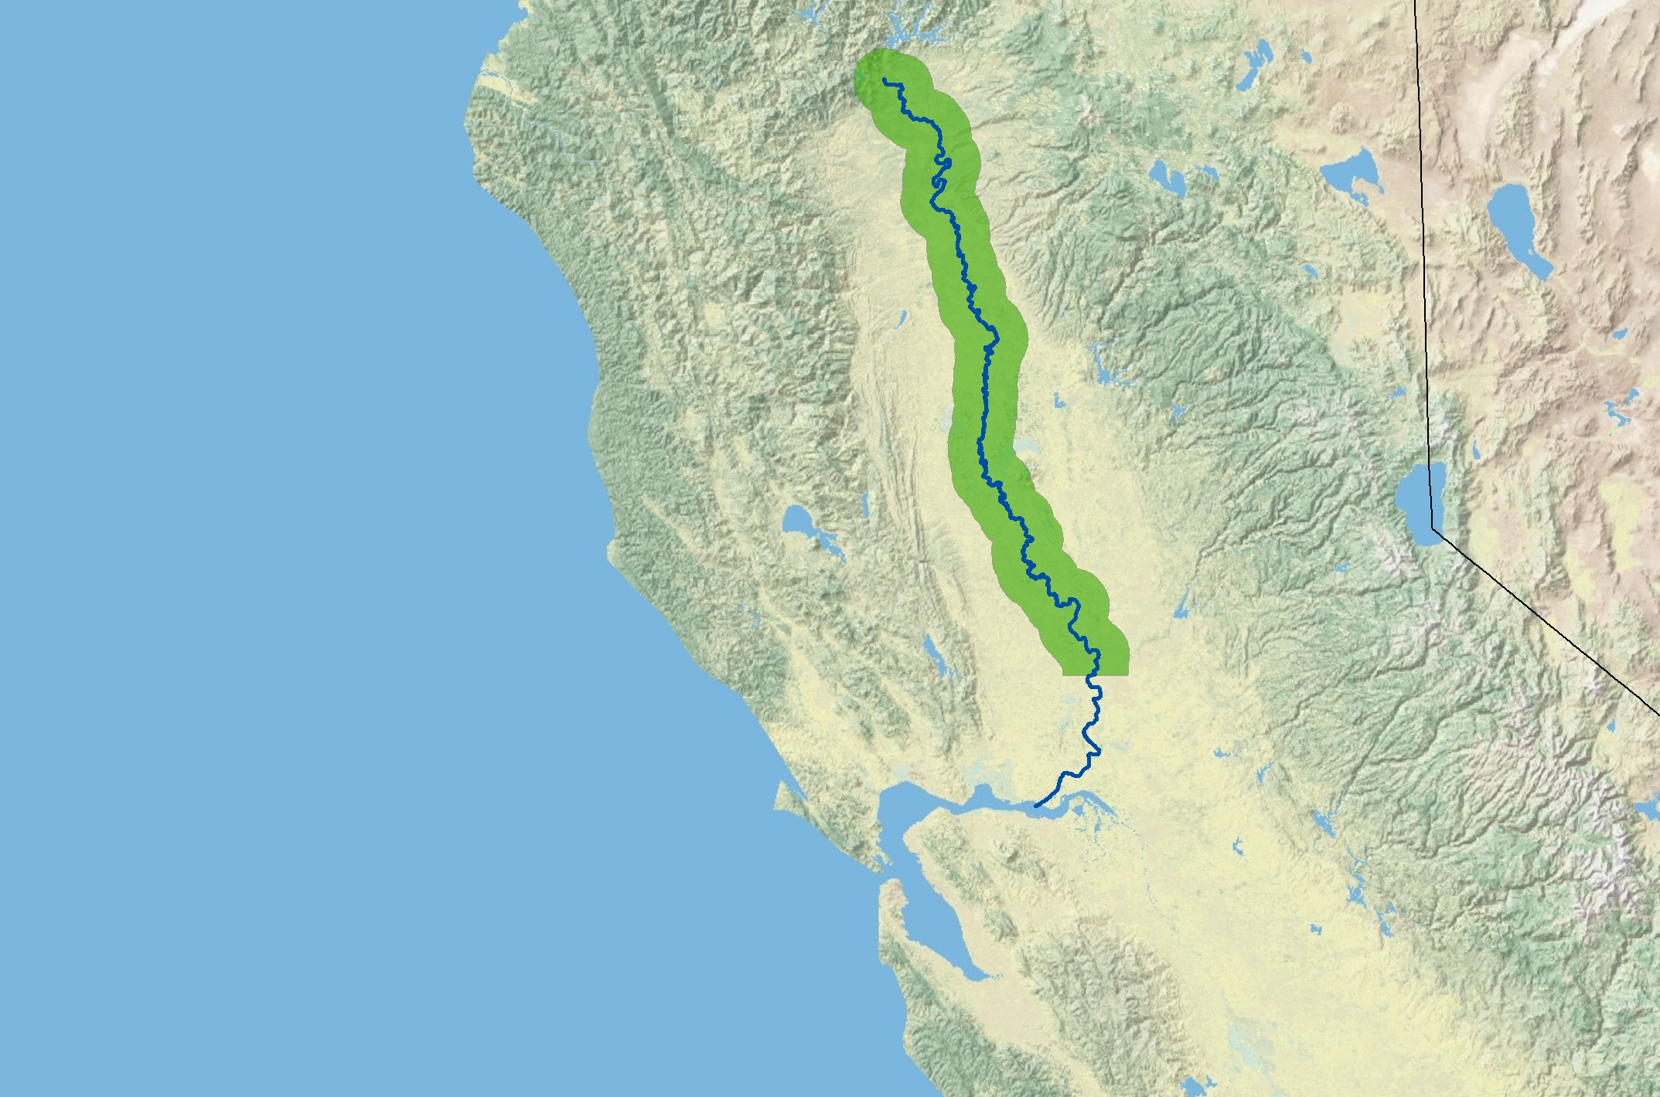
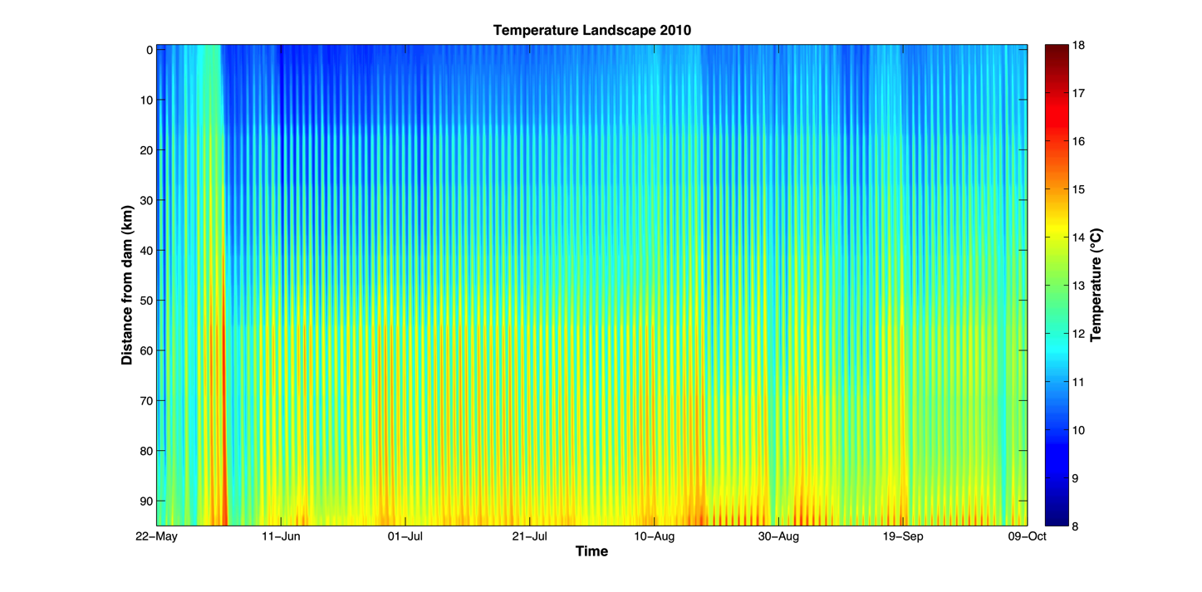
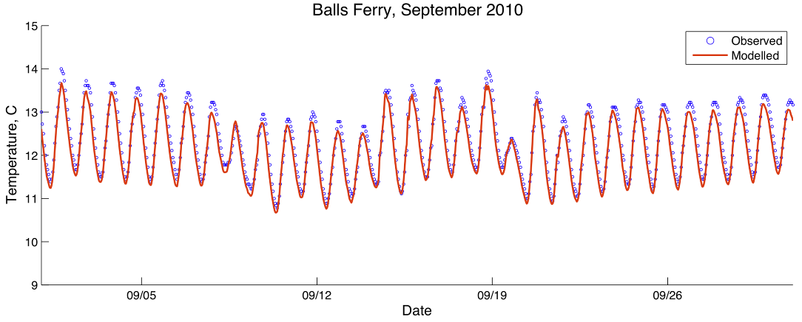
River Models
RAFT
Food Web/ Production
Coupled River Model
Upper Sacramento River
City of Sacramento

Slide 13
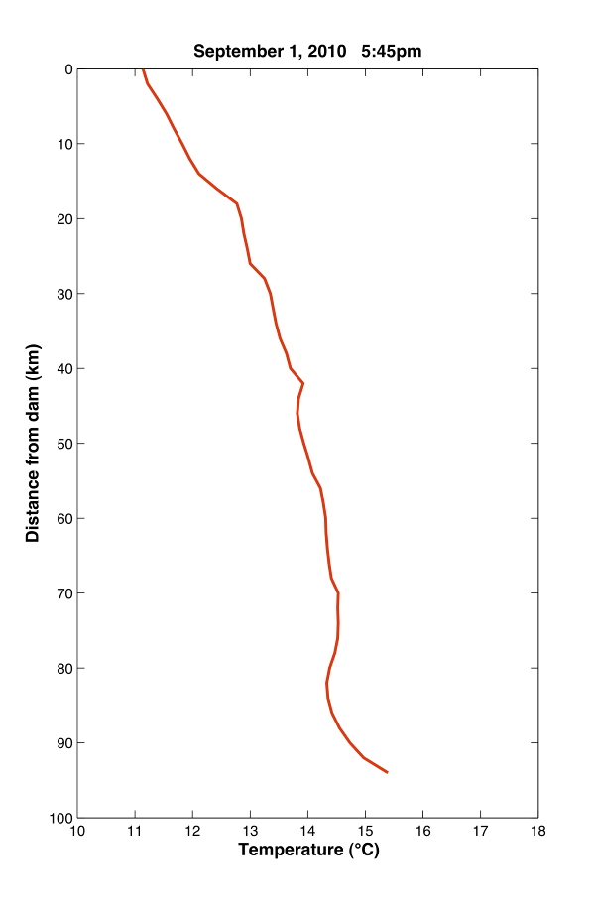
River Models

Slide 14
Difference in Growth: daily vs. hourly models
G _{daily} – G _{subdaily} (g/g)
Temperature
Jul
Aug
Sep

Slide 15
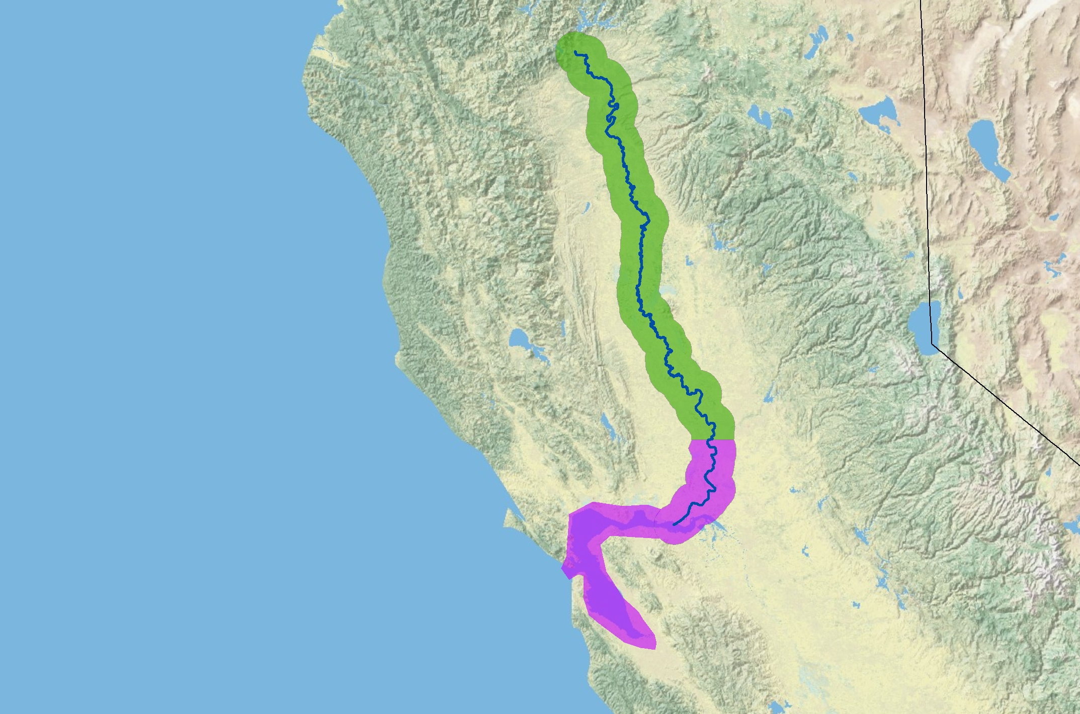
Estuarine Models
City of Sacramento
SELFE
CoSiNE
Coupled Estuary Model
San Francisco Estuary

Slide 16
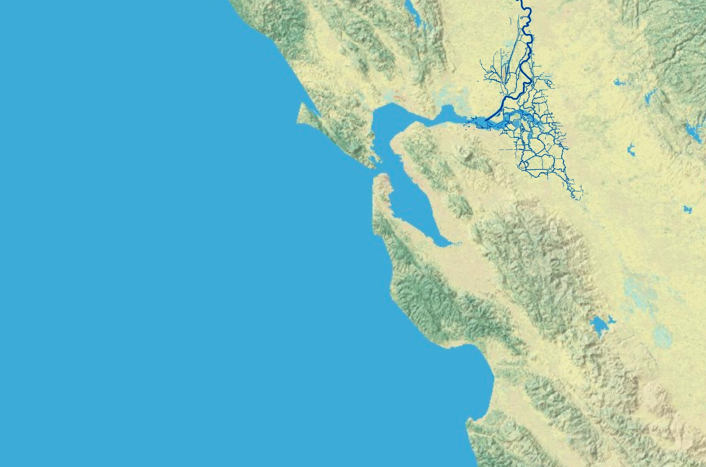
Estuarine Models
Unstructured-grid model
Forcings from TOPS: wind, heat flux and rainfall
Water temperature
Optical depth
Circulation

Slide 17
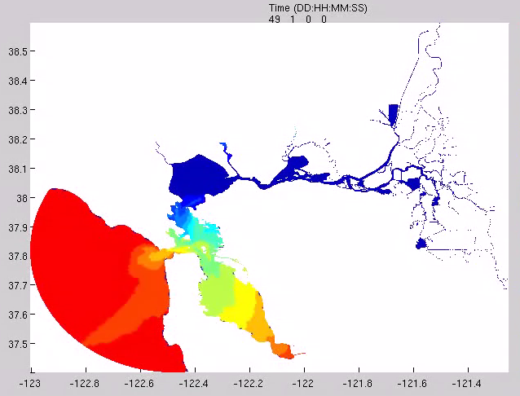
Estuarine Models

Slide 18
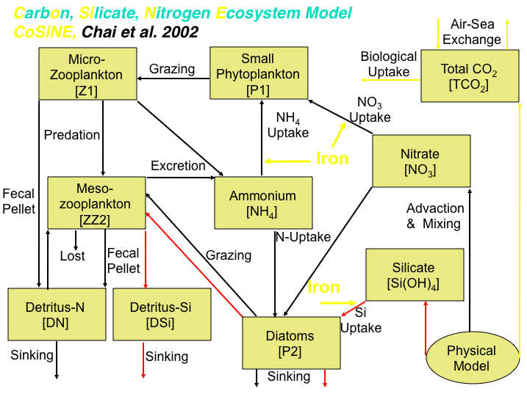
Modeling the estuarine environment (SELFE-CoSiNE)

Slide 19
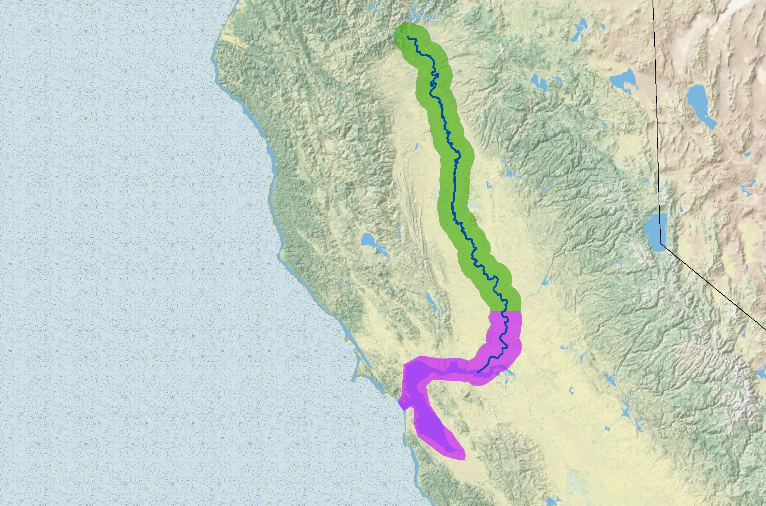
Ocean Models
RAFT
Food Web/ Production
Coupled River Model
Upper Sacramento River
ROMS
CoSiNE
SELFE
CoSiNE
Coupled Ocean Model
Coupled Estuary Model
Coastal Ocean
San Francisco Estuary

Slide 20
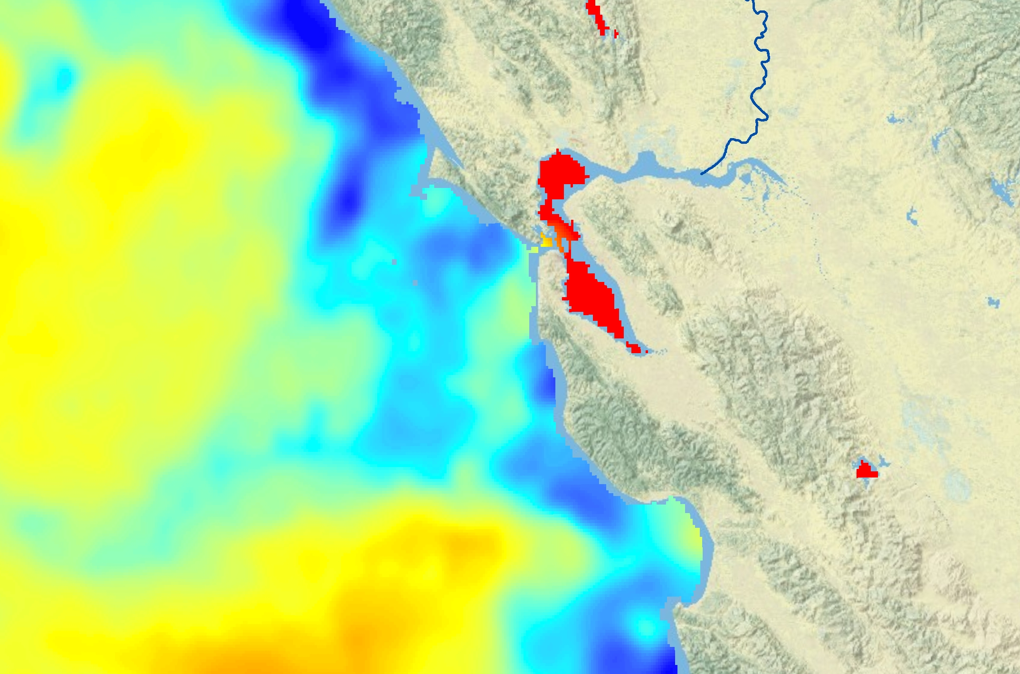
Ocean Models
ROMS ocean temperature

Slide 21
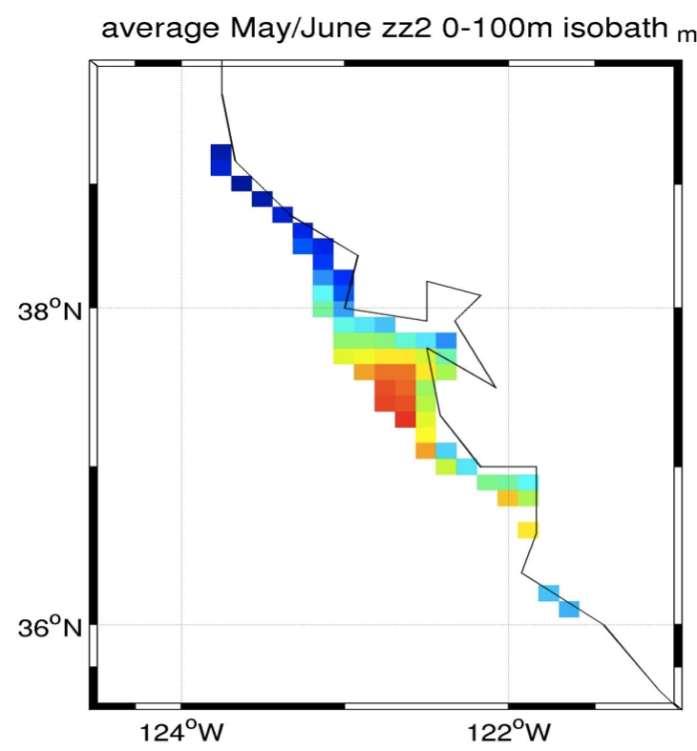
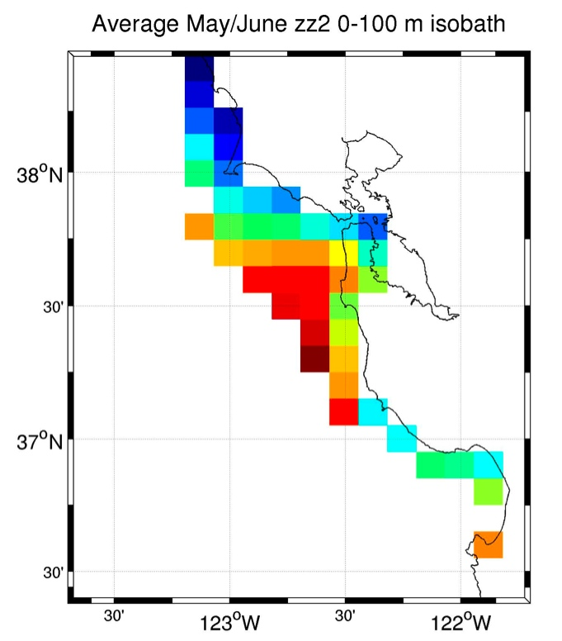
Food density – linking ROMS and CoSiNE
Relationship between mesoscale environmental forcing, krill and salmon
Observed
CoSiNE

Slide 22
Summary
Salmon are important ecologically and economically, from rivers, estuaries, to the ocean - and carry the legacy of effects from system to system
Goal: improve our understanding of how salmon are affected by freshwater dynamics as they grow from eggs to mature adults while moving across these complex landscapes
DEB models integrate across variable environments
A tool to examine how salmon might respond to novel climate conditions
This project integrates data from two key NASA models, TOPS and ROMS, at the land-sea interface

Slide 23
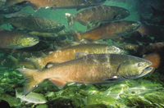

Thank you.
Improving Stream Temperature Predictions for River Water Decision Support Systems
From the watershed to the ocean: Using NASA data and models to understand and predict variations in central California salmon

